Slide 1
CPSC431
PHP and HTTP

Slide 2
Interaction of System Components
User
HTTP Client
HTTP Server
PHP Engine
1. Submit cmd via HTTP client
2. HTTP request
3. Invoke PHP Script
4. Parse script
5. HTTP response content
6. HTTP response
7. Browser screen

Slide 3
HTTP Client – Web Browser
Submit HTTP GET requests
  Enter http://www.hotmail.com/when/junk.php?birthyear=1905&press=OK"
  Use HTML GET form
    <form method="GET" action="junk.php">
    <input type=text name="birthyear">
    <input type=submit name=press value="OK">
    </form>
Submit HTTP POST requests
  <form method="POST" action="junk.php">
  <input type=text name="birthyear">
  <input type=submit name=press value=" OK ">
  </form>

Slide 4
HTTP Client – cURL Client
Submit the HTTP requests via Windows command line
  Submit GET form request
  curl "http://www.hotmail.com/when/junk.php?birthyear=1905&press=OK"
  Submit POST form request
  curl --data "birthyear=1905&press=%20OK%20" http://www.example.com/when.php
More information https://curl.haxx.se/docs/httpscripting.html

Slide 5
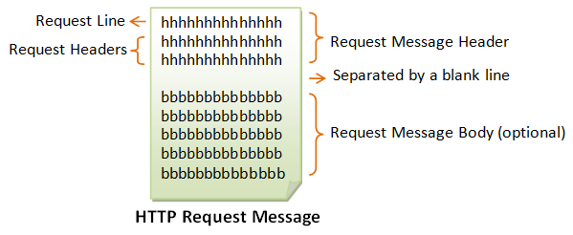
HTTP Request Message

Slide 6
Request Line
request-method-name
  GET, POST, HEAD, and OPTIONS
request-URI : the resource request
  /test.html
  /test.php?name1=value1&name2=value2
HTTP-version : HTTP version in use
  HTTP/1.0 or HTTP/1.1
Examples
  GET /test.html HTTP/1.1
  HEAD /query.html HTTP/1.0
  POST /index.html HTTP/1.1

Slide 7
Request Header
Syntax
request-header-name: request-header-value1, request-header-value2, ...
Examples
  Host: www.xyz.com
  Connection: Keep-Alive
  Accept: image/gif, image/jpeg, */*
  Accept-Language: us-en, fr, cn

Slide 8
Request Message Body
For POST method, it contains (URL-encoded query string)
  POST /bin/login HTTP/1.1
  Host: 127.0.0.1:8000
  Accept: image/gif, image/jpeg, */*
  Referer: http://127.0.0.1:8000/login.html
  Accept-Language: en-us
  Content-Type: application/x-www-form-urlencoded
  Accept-Encoding: gzip, deflate
  User-Agent: Mozilla/4.0 (compatible; MSIE 6.0; Windows NT 5.1)
  Content-Length: 37
  Connection: Keep-Alive
  Cache-Control: no-cache
  User=Peter+Lee&pw=123456&action=login

Slide 9
More information on HTTP Request Message
https://www.ntu.edu.sg/home/ehchua/programming/webprogramming/HTTP_Basics.html

Slide 10
Parse PHP Script
The script is programmed to
  Retrieve the input parameters of HTTP requests via PHP Superglobals
    $_GET, $_POST
    $_REQUEST
    $_FILES
  Retrieve data from persistent data storage via PHP functions from different extensions (e.g. MySQL)
  Generate HTTP response message with the data

Slide 11
Superglobal $_GET
Array containing the parameters sent via GET method
  GET /test.php?name1=value1&name2=value2 HTTP/1.1
  In test.php
    <?php
      @param1 = $_GET[‘name1’]
      @param2 = $_GET[‘name2’]
    ?>

Slide 12
Superglobal $_POST
Array containing the parameters sent via POST method
  In test.php
    <?php
      @param1 = $_POST[‘name1’]
      @param2 = $_POST[‘name2’]
    ?>

Slide 13
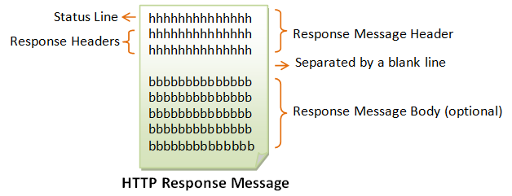
HTTP Response Message

Slide 14
Status Line
Syntax
HTTP-version status-code reason-phrase
Examples
  HTTP/1.1 200 OK
  HTTP/1.0 404 Not Found
  HTTP/1.1 403 Forbidden

Slide 15
Response Header
Syntax
response-header-name: response-header-value1, response-header-value2, ...
Examples
  Content-Type: text/html
  Content-Length: 35
  Connection: Keep-Alive
  Keep-Alive: timeout=15, max=100

Slide 16
Response Message Body
HTTP/1.1 200 OK
Date: Mon, 27 Jul 2009 12:28:53 GMT
Server: Apache/2.2.14 (Win32)
Last-Modified: Wed, 22 Jul 2009 19:15:56 GMT
Content-Length: 88
Content-Type: text/html
Connection: Closed
<html>
<body>
<h1>Hello, World!</h1>
</body>
</html>

Slide 17
Generate HTTP response message
Use echo() to dynamically generate the HTML tags (with data)
  <html>
  <body>
  <?php>
  $a = ‘Hello, World!’;
  echo(“<h1>$a</h1>”);
  <?>
  </body>
  </html>
Use header() function to customize the response headers (by default Content-Type is text/html)
header(“Content-Type: application/pdf”);
header(‘Content-Length: ‘ . Strlen($data);

